Slide 1
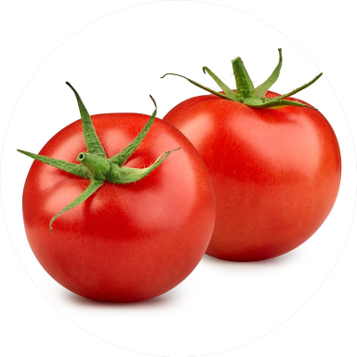

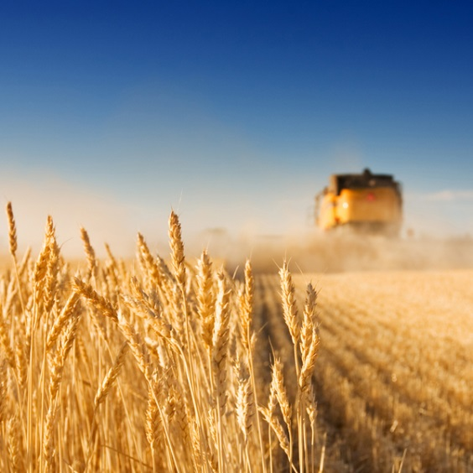

“Predicting fungal infection sensitivity of sepals in harvested tomatoes using Imaging Spectroscopy and Partial Least Squares Discriminant Analysis”.
Mercedes Bertotto¹, Hendrik de Villiers¹, Aneesh Chauhan¹, Esther Hogeveen-van Echtelt¹, Manon Mensink¹, Zeljana Grbovic², Dimitrije Stefanovic², Marko Panic², Sanja Brdar²
¹Wageningen University and Research, Netherlands
²Biosense Institute, Serbia
Notes:
GOOD AFTERNOON EVERYBODY

Slide 2
Table of contents
1) Introduction to the problem
2) Theory
3) Materials and methods
Samples
Data description and analysis
4) Results
5) Conclusions

Slide 3
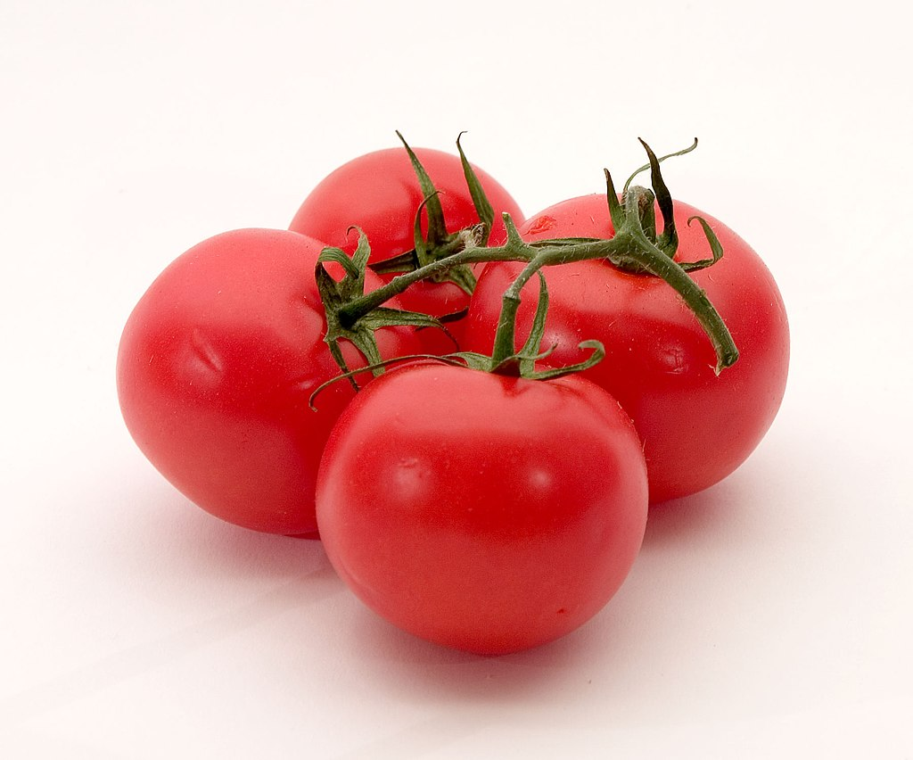
Part 1: Introduction to the problem

Slide 4

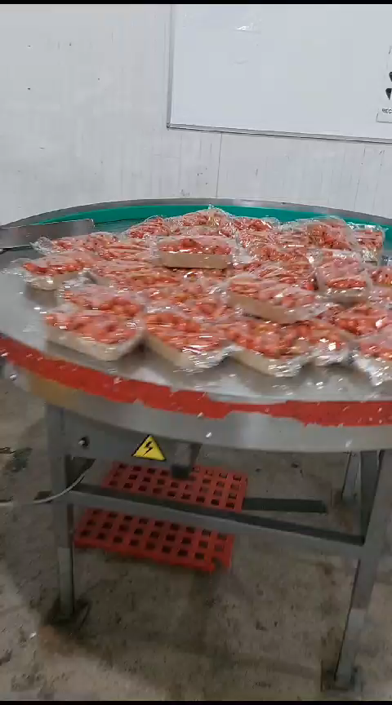

Problem definition
Source: Videos recorded by me under project number 6230217000
Notes:
tomato

Slide 5
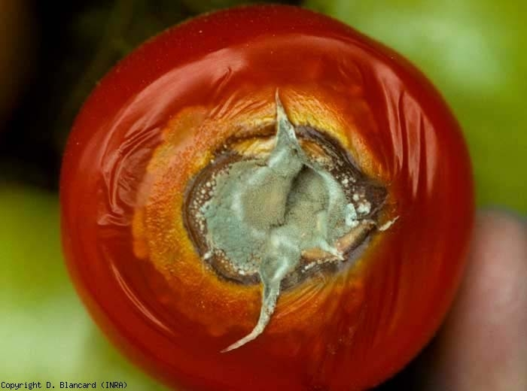


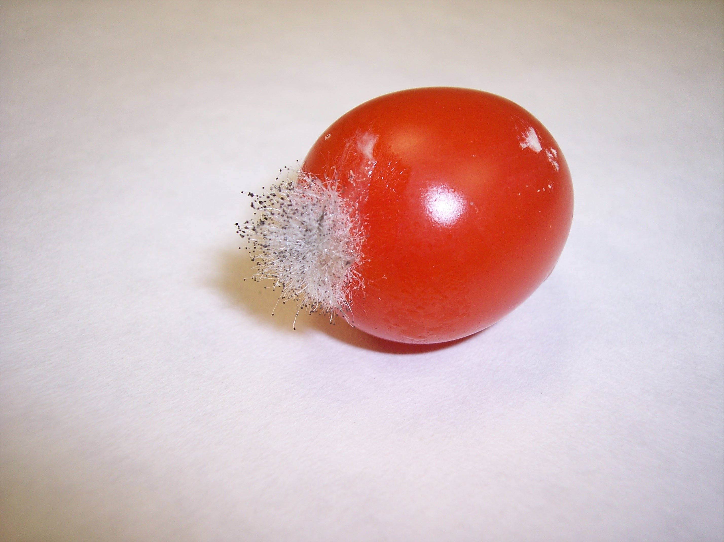
Problem definition
Motivation: tomato - highly sensitive during harvest and post-harvest processes (transport, packaging and storage), susceptible to pathogenic fungi
This leads to post-harvest losses, reaching up to 30% in some developing countries
Early weakness of the sepals is not visible to the naked eye - no method exists of detecting this automatically prior to the infection
Aspergillus
Penicillium
Mucor
????

Slide 6
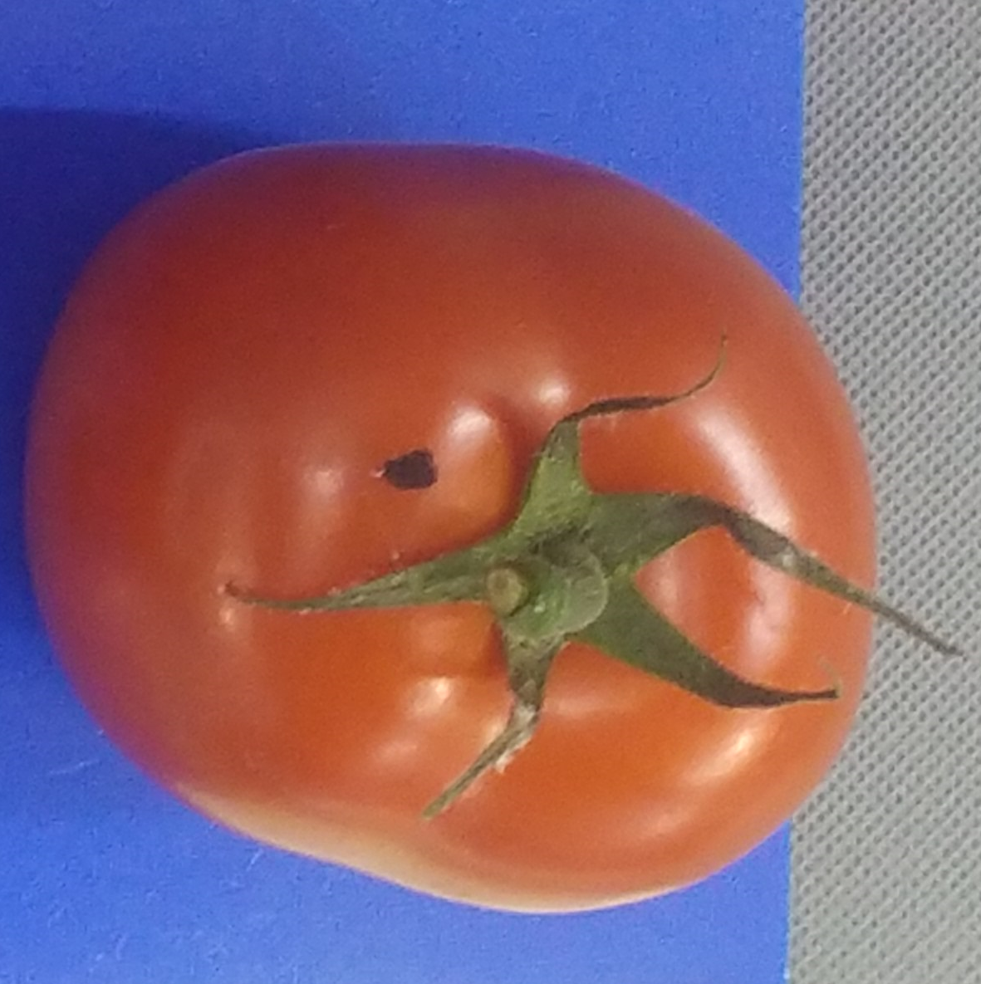
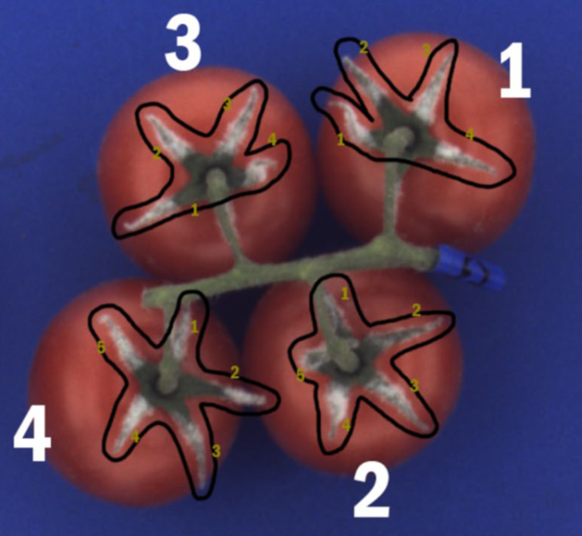
It begins ...
... and it gets worse (after 5 days)

Slide 7
Objectives of this feasibility study
Investigate if there is a correlation between the hyperspectral data captured at harvest and the fungal infection observed 3 and 4 days later by chemometrics using wrapping methods and PLSDA
Calibrate and validate intravariety, intervariety and global model to grade the susceptibility to fungal infection, and to identify important wavelengths as input for the model

Slide 8
Part 2: Theory

Slide 9
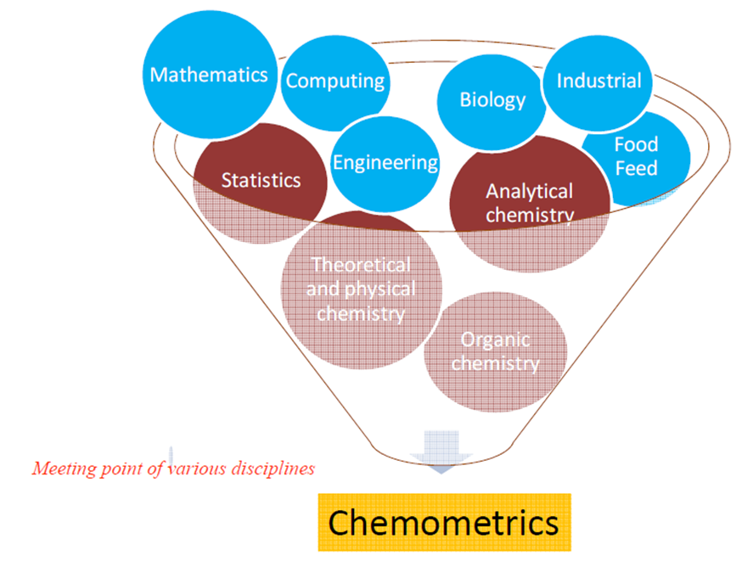
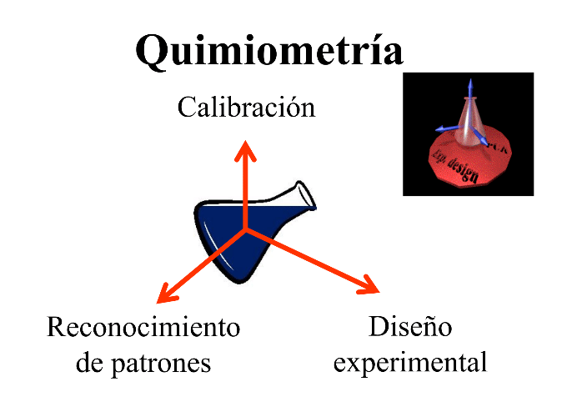
Chemometrics
“Chemometrics is the chemical discipline that uses mathematical, statistical, and other methods employing formal logic to design or select optimal measurement procedures and experiments, and to provide maximum relevant chemical information by analyzing chemical data“. D. L. Massart (1941-2005)
Multivariate calibration
Pattern recognition
Design of Experiments
Notes:
This is the currently accepted definition in the NIR community
Chemometrics is a discipline that uses mathematics, statistics and computer science to address problems related to:
Patter recognition
Multivariate calibration
Design of experiments
Therefore, it is inherently interdisciplinary.
It is used to solve problems in
chemistry, biochemistry, medicine, biology and chemical engineering.

Slide 10

Why Chemometrics? Why Linear Algebra?
NIR spectra are of high dimension
The data are highly correlated (collinearity problem) and obscured by the presence of overlapping absorbances, harmonics, and combination bands
Spectra are often complicated by light scattering and other physical effects
Multivariate methods (chemometrics) are required to address these issues
“Linear algebra is the language of chemometrics. To understand most chemometric techniques, a basic understanding of linear algebra is required." (Wise and Gallagher, 1998)
Notes:
Nowadays, analytical methods provide data with high dimensionality
Near infrared spectroscoppy, Raman, MIR, CGMS,
3 different problems
high number of variables that are correlated
We work with overtones and combination bands,, overlapping bands
Spectra are influenced by physical effects
That is why, we need multivariate analysis to address these issues.
There's no time, but I would have loved to explain this as well

Slide 11
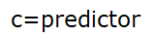
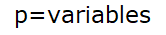
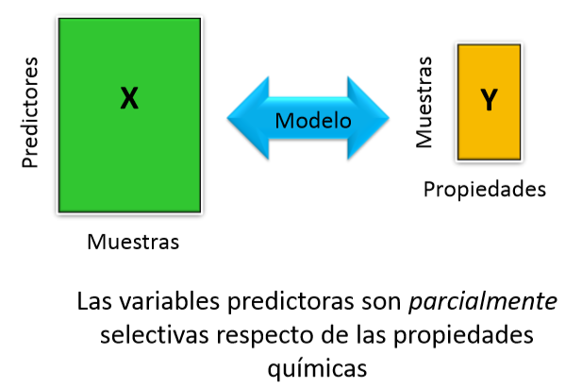

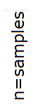

Multivariate analysis
Model
The predictor variables are partially selective of the chemical properties
Notes:
In univariate quantitative analysis, the analyte concentration is obtained by introducing a univariate instrumental signal into a calibration curve. It only works if the predictor variable is specific to the chemical property. On the other hand, in multivariate quantitative analysis, the property is obtained using multivariate instrumental signals and a specific algorithm. The predictor variables are partially selective of the chemical properties.
Samples are referred to as OBJECTS
- Measurement results (e.g. concentration, absorbances, …) are referred
to as VARIABLES
-A data table of K variables and M objects is referred to as a DATA
MATRIX OF SIZE MxK

Slide 12
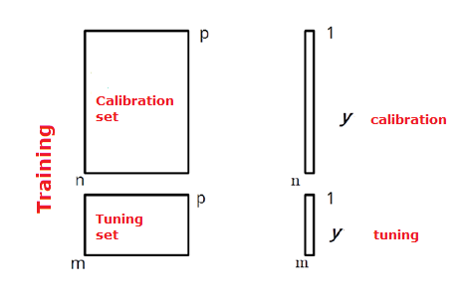
Data Set Preparation
GOOD MODELING PRACTICES (GMP)
Notes:
Data set can be split in two or three sets, if we split it in three sets, we have two different options
Use the calibration set to create the model, use the tuning set to tune the parameters of that model. Then, validate the trained model in the test set.
Another option is to calibrate and tune the model with the calibration set, using cross validation or splitting it again. Then perform and internal validation with samples from the same data set, and a external validation with new samples. Moreover, you can also do external validation with the same dataset, in that case you split the data set in three.
The first stage in establishing a predictive model involves splitting the spectral collection into two sets: learning and test sets. The first will be used to fine-tune the predictive model, and the test set will be used to estimate the quality of the predictive model.
The term 'set' refers to spectra selected using an alternative spectroscopic method, and the term 'value' refers to the reference method.
The division can be performed using different algorithms that we will see later on.
Con respecto al CovSel, yo use el set de validacion para tunear el numero de variables. En ese caso, un nuevo juego de datos seria necesario
Si usamos el set para tunear los parametros, entonces no lo podemos usar como validacion, y necesitamos un nuevo set de datos independiente para validar el modelo
You have used the validation set to tune the parameters, then it is not longer a validation set.
You cannot use it as a validation set as well, their performance as a validation set is compromised, because you have used it to tune the parameters
You have used this data set in order to tune the parameters, therefore you cannot use it as a validation set
If you have used the validation set to tune the parameters, then it is no longer a validation set
This model is not properly validated. You need to validate this model in a correct manner
You need to validate the model with new, independent samples that have not been used to tune the parameters
You need to validate the model with new, new totally independent samples, samples that were never seen by the model

Slide 13
Feature selection methods

Slide 14
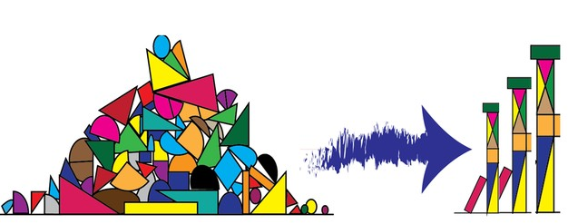
Feature selection
Increasing the number of variables:
Introduces unnecessary NOISE for discrimination, especially if they are strongly correlated
Carries a risk of OVERFITTING the models
Using a simple model with few variables has a better chance of being generalized to a new sample than a model with hundreds of variables, which may fit the training set perfectly well but has limited generalization power
3 Approaches:
Variable Transformation and/or Selection
Discretization
Group Summary
Notes:
Además, si se construye un modelo con la intensión de ser utilizado en rutina, es generalmente más eficaz y económico, tener que medir solo algunas variables.
A pesar de que algunos métodos como PLS puede tolerar la redundancia de variables.
Predictive models use relationships between one or more features to predict the value of a response feature, such as power.
However, including additional predictors like the color of the car that are unrelated to the response will not provide additional benefits and may even affect the model's performance.
The goal of feature selection is to enhance your model by retaining only the features that add value and discarding the rest.
The resulting model will also be simpler to interpret and more computationally efficient.

Slide 15
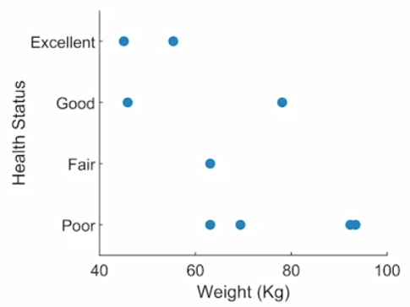
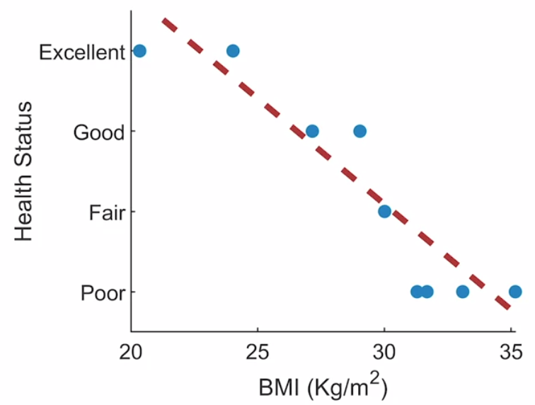
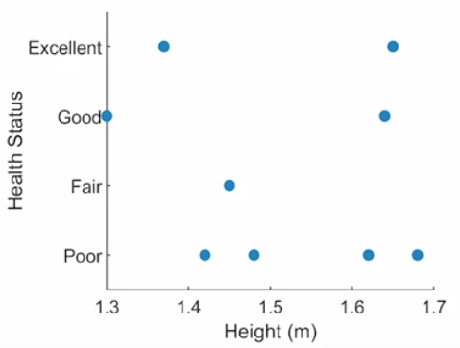
Variable transformation
TRANSFORMACION DE VARIABLES
This involves applying an equation to existing variables to create a new feature
Example: Is it possible to accurately classify the health status of each individual from the original variables of age, height, weight and location?
BMI= Weight (Kg)
Height (m)²
No clear correlation
Correlation
Notes:
For example, consider this dataset containing information about hospital patients, with one row for each individual.
The initial question is, "Is it possible to accurately classify the health status of each individual from the raw variables of age, height, weight, and location?" To start, we can input the raw variables into a model and attempt to compare, for instance, health status with weight or height.
However, a quick visualization reveals that these variables on their own are not good for predicting health status because there is no clear correlation. So, what can we do?
Well, you can begin the process of feature engineering. It is possible to enhance a model's predictive power by applying domain knowledge to generate useful features. There might be many features that are better predictors of a patient's health status than the original variables on their own. Visualizing the BMI (Body Mass Index) shows that it is indeed more correlated with the patient's health status than weight or height alone.
The second approach of discretization involves dividing the data into groups using a numerical variable. This can be helpful because sometimes the important aspect of a variable is not its exact value but the range in which it exists.
For instance, the age variable naturally lends itself to grouping patients into three categories: child, adult, and senior. You can then add this categorical variable as a new feature to the table.
Discretization is the process by which we can transform continuous variables, models, or functions into a discrete form. This is done by creating a set of continuous intervals (bins) that span the range of our desired variable, model, or function.
Why Discretization is Important: Mathematical problems with continuous data have an infinite number of degrees of freedom. Sometimes, it's necessary to limit these degrees of freedom because calculations cannot go on indefinitely.
It is often easier to understand continuous data (like weight) when they are divided and stored in meaningful categories or groups.
Finally, the third approach is to summarize groups within your data. For example, how does a patient's weight compare to the rest of their age group? To find out, calculate the average weight for each category.
Then, append this result to your table as a new variable. Next, you can calculate the difference between each individual's weight and the average.
Each of these approaches can be applied to any dataset. However, the exact implementation depends on your knowledge of the data itself. In theory, you can generate an infinite number of new features, but only a few will prove to be truly useful.

Slide 16
Variable selection methods
Filter
Wrapping
Embedded
Notes:
Hay tres tipos de métodos de selección de funciones, envoltorio, incrustado y filtro.
FILTER METHODS.
Filter methods are used before training the model. They are based on the statistical properties of the predictors and their relationship with the response.
FILTERS: Filters are used for a preliminary variable selection before more sophisticated methods. That is, they are typically used in combination with wrapper and embedded methods.
They involve evaluating the intrinsic characteristics of the data independently of the specific problem considered. They can be applied regardless of the model.
Select a significance level α (e.g., α = 0.20 or α = 0.157). • Conduct K univariate models. • Use all variables in a multivariate model with a univariate p-value < α. • Sometimes followed by backward elimination.
Simple method, can be calculated by any computer, but it only works properly with UNCORRELATED VARIABLES
A Filter method Example: Variance Thresholds
Here, we simply compute the variance of each feature, and we select the subset of features based on a user-specified threshold. E.g., “keep all features that have a variance greater or equal to x” or “keep the the top k features with the largest variance.” We assume that features with a higher variance may contain more useful information, but note that we are not taking the relationship between feature variables or feature and target variables into account, which is one of the drawbacks of filter methods.
Forward Selection:
Select a significance level α1.
Estimate the model.
Repeat:
While the most significant term has p < α, add it and re-estimate. Variant: Forward, in steps.
Select two significance levels α1 and α2.
Repeat:
While the most significant term excluded has p < α1, add it and re-estimate.
While the least significant term included has p > α2, remove it and re-estimate.
Backward Selection:
Select a significance level α2.
Estimate the full model.
Repeat:
While the least significant term has p > α2, remove it and re-estimate. Variant: Backward, in steps.
Select two significance levels α1 and α2.
Repeat:
While the least significant term included has p > α2, remove it and re-estimate.
If the most significant term excluded has p < α1, add it and re-estimate.

Slide 17
Wrapping
methods
These variable selection methods depend on model performance. It is an iterative process of back and forth, where the chosen features are evaluated in relation to the final model performance in sequential stages.
Variable
Train the model
Variable
Best features
Variable
Variable selection
Evaluation of model performance
Optimized model
Notes:
Wrapper methods train a new model for each subset and use the model's error rate on a hold-out set to score feature subsets.
This involves an iterative process between feature subset selection stages and subset evaluation stages using the chosen learning method.
The forward method works as follows:
Without loss of generality, let's consider a regression problem. It starts by selecting the variable that best addresses the problem, meaning the variable most correlated with the target variable. Then, it looks for the variable that is most associated with the first one through a multiple regression. This process continues until all variables are introduced. Different criteria are used to choose the best model among the stages performed.
To prevent overfitting: Cross-validation.
we have to train and cross-validate our model for each feature subset combination

Slide 18
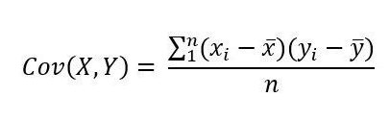
Covariance
Indicates the degree of joint variation between two random variables with respect to their means
It can be used to understand the direction of the relationship between two variables
The correlation coefficient is equal to the covariance divided by the product of the standard deviations of the variables
Notes:
La covarianza mide la relación lineal entre dos variables. Aunque la covarianza es similar a la correlación entre dos variables, difieren de las siguientes maneras:Los coeficientes de correlación están estandarizados. Por lo tanto, una relación lineal perfecta da como resultado un coeficiente de 1. La correlación mide tanto la fuerza como la dirección de la relación lineal entre dos variables.
Los valores de covarianza no están estandarizados. Por consiguiente, la covarianza puede ir desde infinito negativo hasta infinito positivo. Por lo tanto, el valor de una relación lineal perfecta depende de los datos. Puesto que los datos no están estandarizados, es difícil determinar la fuerza de la relación entre las variables.
Los valores de covarianza positivos indican que los valores por encima del promedio de una variable están asociados con los valores por encima del promedio de la otra variable y los valores por debajo del promedio están asociados de manera similar. Los valores de covarianza negativos indican que los valores por encima del promedio de una variable están asociados con los valores por debajo del promedio de la otra variable.
Por lo tanto, una covarianza positiva siempre producirá una correlación positiva y una covarianza negativa siempre generará una correlación negativa
However, variance can only be used to explain the spread of the data in the directions parallel to the axes of the feature space.
The diagonal spred is captured by the covariance

Slide 19
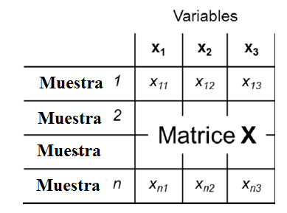
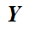
Wrapping method: Covariance selection (CovSel)
In each iteration, one variable X is selected on a criterion of the maximization of the covariances with Y
Once the variable with the highest covariance is isolated and selected, all other predictive factors and responses are orthogonalized with respect to it, and the process is repeated until the fixed number of variables has been selected
Notes:
CovSel is a variable selection method designed to identify the most relevant features in a regression context. As the name suggests, the relevance of each variable is assessed by estimating the covariance between each predictor and the responses. Once the variable with the highest covariance is singled out and selected, all other predictive factors and responses are orthogonalized with respect to it, and the procedure is repeated until a fixed number of variables has been selected
CovSel aims to iteratively select variables from a predictive variable matrix X with N rows and P columns, which have good predictive capability for the variables combined in a matrix Y with N rows and Q columns. The variables selected in the end will be relatively few in relation to P. The most commonly encountered case is when a single variable needs to be predicted (Q=1), but here we will address the general case where Q can potentially be greater than 1. In each iteration, the variable X is selected based on the criterion of maximizing covariances with Y

Slide 20
Covariance selection (CovSel)
The selected variables from X should have:
Good predictive power for Y
The highest possible variability
Notes:
The first stage of CovSel involves evaluating the covariance between the columns of X and Y.
The output matrix X is centered, and the matrix Y is centered and scaled (the intensities of the Y variables are not intended to play a role in the selection).
All covariances between the columns of X and Y can be directly calculated as follows:
The covariance matrix C has dimensions QxP. An element Cij of C gives the covariance between the variable with index I of Y and the variable with index j of X.
The number of variables (L) to be selected from the Xdata block is defined.
The Xblock is centered on the mean, and Y is autoscaled (resulting in Xp and Yp, respectively).
The covariance between each variable Xp (xp, i) and Yp is calculated.
The predictor xSel, l with the highest covariance with Yp is selected.
Xp is orthogonalized with respect to the selected variable xSel, resulting in XO.
After the sixth step, you start again from the third step, replacing Xp with XO, and repeating all the steps L-1 times.
Note that in step 4, Xsel is selected but not removed from Xp.
Also, note that the CovSel algorithm follows the same pattern as the NIPALS PLS. In both, covariance is maximized, but in CovSel, the construction of a latent variable is replaced by variable selection.
El criterio de la maximización de las covarianzas reposa sobre la idea de que las variables de X seleccionadas deben presenter dos características:
Deben presenter un buen poder predictivo de Y
Deben presenter la mayor variabiliad possible. De la misma manera que en la regression PLS, se tiene interés en dar la mayor importancia a las variables en X que son las más intensas. Como el ruido aleatorio depende en general de sus intensidades, la elección de una variable intensa aporta menos importancia relativa al ruido.
The criterion of maximizing covariances is based on the idea that the selected X variables should possess two characteristics:
They should exhibit good predictive power for Y.
They should have the highest possible variability. Similarly to in PLS regression, there is an interest in giving greater importance to the variables in X that are the most intense

Slide 21
Embedded
methods
They automatically perform feature selection as part of the model training
The result is a trained model that highlights the useful features and disregards the rest
Train the model
Optimized model
Variable
Variable
Useful variables
Variable
Useless features
Feature selection
Notes:
Integrated methods, or a class of machine learning models, automatically perform feature selection as part of the model training process.
The result is a trained model that emphasizes useful features and disregards the rest.
Both wrapper methods and integrated methods rely on model performance to guide feature selection.
Wrapper methods consider unimportant features iteratively based on the evaluation metric, while Embedded methods perform feature selection and training of the algorithm in parallel. In other words, the feature selection process is an integral part of the classification/regressor model.
An Embedded Method Example: L1 Regularization
L1 (or LASSO) regression for generalized linear models can be understood as adding a penalty against complexity to reduce the degree of overfitting or variance of a model by adding more bias. Here, we add a penalty term directly to the cost function,
regularized_cost = cost + regularization_penalty
In L1 regularization, the penalty term is
L1 : λ Σ^{k}_{i}w_{i}= λw₁,where w is our k-dimensional feature vector. Through adding the L1 term, our objective function now becomes the minimization of the regularized cost, and since the penalty term grows with the value of the weight parameters (λ is just a free parameter to fine-tune the regularization strength), we can induce sparsity through this L1 vector norm, which can be considered as an intrinsic way of feature selection that is part of the model training step.

Slide 22
Cross validation and Data Split

Slide 23
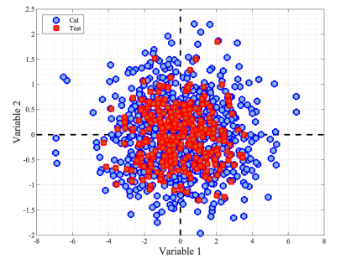
Some methods for the selection of Representative Learning and Test Sets
Onion
Kennard-Stone
Randomly
Kernnand Stone
Onion
Duplex
Reducennsamples
Source:https://eigenvector.com/wpcontent/uploads/2022/10/Onion_SampleSelection.pdf
Notes:
The Kennard-Stone (KS) algorithm starts by finding two samples in that have the largest Euclidean distance; these are the two samples furthest
apart. Subsequent points are selected that maximize the Euclidean distance from previously selected points. The result is that, for a given fraction (fraction) of the data to be parsed into the calibration set,
samples are selected to smoothly fill the data space. The remaining samples are placed into the test set.
3) Onion selects an exterior set of samples for calibration and the next exterior layer as test samples. The procedure is repeated for non-onion layers with the remainder interior samples randomly assigned to calibration and test sets. This method first selects a ring of the most unique samples (based on distance from the mean), like the outer most layer of an onion. These are used in the calibration set. Next, a ring of less unique samples, just inside the first set (the next onion layer), is put into the validation set. This is repeated two more times, so there are three outer rings of most unique and less unique samples. Finally, all the remaining samples are split randomnly into calibration and validation.
Distance measure: Euclidean does simple, non-scaled distance. Mahalanobis scales each direction by the covariance matrix (correcting for unusually small or large directions).

Slide 24
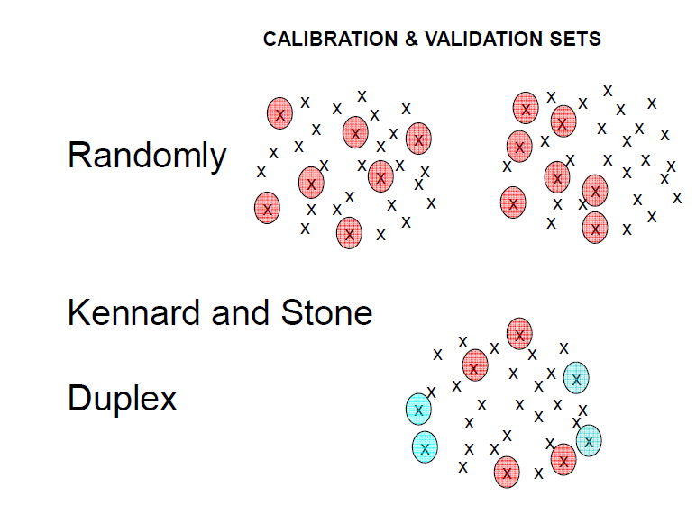
Some methods for the selection of Representative Learning and Test Sets
Duplex
Randomly
Randomly
Kernnand Stone
Onion
Duplex
Reducennsamples
Source:https://eigenvector.com/wpcontent/uploads/2022/10/Onion_SampleSelection.pdf
Notes:
Kernnard-Stone selects a subset of samples which uniformly cover the data set and includes exterior samples as the calibration set. The remainder are placed in the test set.
This method selects samples that best span the same range as the original data, but with an even distribution of samples accross that range.
The Kennard-Stone (KS) algorithm starts by finding two samples in that have the largest Euclidean distance; these are the two samples furthest
apart. Subsequent points are selected that maximize the Euclidean distance from previously selected points. The result is that, for a given fraction (fraction) of the data to be parsed into the calibration set,
samples are selected to smoothly fill the data space. The remaining samples are placed into the test set.
2) Reducennsamples
Select a subset of samples by removing nearest neighbors. . Performs a selection of samples which fill out the multivariate space by removing samples which are similar to each other based on nearest neighbor distance. This algorithm is useful in selectin the minimun number of samples needed to define a subspace and reduce the number of reference measurements needed, or amount of data needed to be stored.
Initially, the nearest neighbor of each sample is found along with the distance between the neighbors. Of the two nearest samples, one is excluded from the data and the distances are recalculated. This process is repeated until the either the smallest distance between samples reaches a maximun limit, or the number of samples reaches a lower limit.

Slide 25
Cross validation
Leave One Out:
Over-estimates the predictive capacity of the model
Use only when data set has few samples
Notes:
"The most commonly used method for determining the optimal number of latent variables is cross-validation, which calculates the accuracy of predictions for models with an increasing number of latent variables. In its simplest implementation, the data matrix is repeatedly split into two parts, one part (calibration samples) is used to build calibration models with different numbers of latent variables, and the other part (validation samples) to calculate prediction errors.
After applying this procedure to all samples, for each of the models with different numbers of latent variables, an average value for the sum of squared prediction errors, or PRESS, is calculated. The optimal dimensionality for the PLS regression model is the one that minimizes this PRESS or RMSECV value.“
"To increase the precision of the predictive model, it is useful to perform the validation experiment multiple times, reassigning observations to different sets.
General outline of cross-validation: In practice, the calibration set is divided into separate segments of the same size. Each segment forms a validation set each time. The division can be done in various ways. One particular case is Leave One Out, where one sample is removed at a time. Leave One Out: Overestimates the predictive capacity of the model."

Slide 26
Discrimination (PLSDA)

Slide 27
Partial Least Squares Discriminant Analysis
Objective: To achieve a linear transformation that maps the data into a lower-dimensional space with the least possible error
Supervised version of PCA
In PCA, the transformation preserves (in its first principal component) the maximum possible variation in the original data
In PLS-DA, the transformation preserves (in its first principal component) the maximum possible covariance between the original data and their labeling
Both can be described as iterative processes in which the error term is used to define the next principal component
Notes:
Partial Least Squares Discriminant Analysis (PLS-DA) is a linear classification method that combines the properties of Partial Least Squares regression with the discriminative power of a classification technique. PLS-DA is based on the PLS regression algorithm (PLS1 when dealing with a single dependent variable Y and PLS2 in the presence of multiple dependent variables Y) which seeks latent variables with maximum covariance with the Y variables. Relevant sources of data variability are modeled by these latent variables (LV), which are linear combinations of the original variables, allowing for graphical visualization and understanding of different data patterns and relationships through the scores and loadings of LV.
PLS1 – Variance is extracted individually for each y. A different set of factors for each y.
PLS2 – Variance is related to several y variables simultaneously. Only one set of factors.
PLS-DA can be considered a 'supervised' version of Principal Component Analysis (PCA) in the sense that it achieves dimensionality reduction but with full awareness of class labels. Besides its use in dimensionality reduction, it can be adapted for feature selection as well as for classification. The goal of dimensionality reduction methods like PCA and PLS-DA is to find a linear transformation that maps the data into a lower-dimensional space with minimal error. If we think of the original data matrix as a collection of m-dimensional vectors (i.e., X is an x by m matrix), the above objective can be seen as finding the transformation matrix A of am × d that optimally transforms the data matrix X into a collection of n d-dimensional vectors S. Hence, S = XA + E, where E is the error matrix. The S matrix, with its rows corresponding to the transformed vectors, provides d-dimensional scores for each of the n vectors in X. In PCA, the transformation preserves the maximum possible variation in the original data (in its first principal component). In PLS-DA, the transformation preserves the maximum possible covariance between the original data and its labeling (in its first principal component). Both can be described as iterative processes where the error term is used to define the next principal component. As mentioned earlier, PCA and PLS-DA are seen as unsupervised and supervised counterparts of dimensionality reduction tools. The new features representing the reduced dimensions are known as principal components.
PLS Discriminant Analysis (PLS-DA) is performed to enhance the separation between groups by rotating the PCA (Principal Component Analysis) components to achieve maximum class separation and to understand which variables carry class separation information. PLS-DA consists of a classical PLS regression where the response variable is a category expressing unit class membership. Therefore, PLS-DA does not allow for response variables other than defining the groups of individuals. As a result, all measured variables play the same role in terms of class assignment. In reality, PLS components are created by trying to strike a suitable compromise between two purposes: describing the set of explanatory variables and predicting the response variables. A classification based on PLS should benefit from this property towards constructing typologies with intrinsic predictive power."

Slide 28
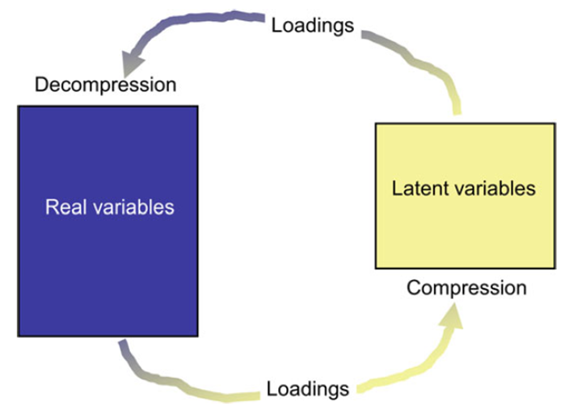
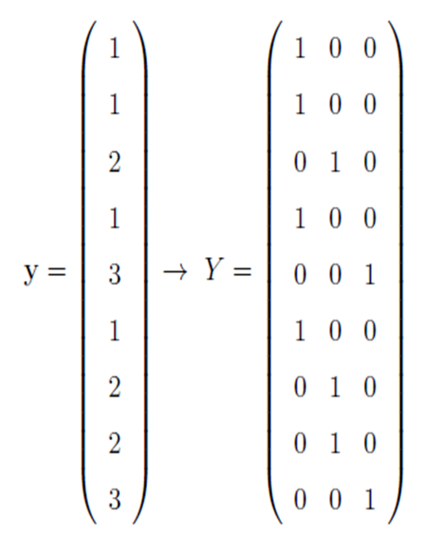
Partial Least Squares Discriminant Analysis
It consists of a classical PLS regression where the response variable is a category expressing the membership of samples in classes
The relevant sources of data variability are modeled by the Latent Variables (LVs) which are linear combinations of the original variables
A fictitious matrix (Y) that records membership with 1s and 0s is combined with a spectral set (X), and PLS is implemented in the normal manner
Notes:
It consists of a classical PLS regression where the response variable is a category expressing the membership of samples in classes. All measured variables play the same role with regard to class assignment.“
Rotating the A (Principal Component Analysis) components is also performed in order to achieve maximum separation between classes and to understand which variables carry the class separation information
The PLSDA calculation procedure consists of the following stages:
Construction of the complete disruptive code for the matrix Y associated with Y,
Using the PLS2 method, with the quantitative variables X as predictors and Y as the matrix to predict
DISRUPTIVE CODE: It is observed that to create this complete disruptive code Y associated with y, the matrix has as many columns as classes, and each row contains only one membership. The rank of Y is equal to K-1

Slide 29
Partial Least Squares Discriminant Analysis
PLS-DA provides estimated values for each sample and for each class.
These values will not be exactly 1 or 0; however, if the calculated y is closer to 0, then the sample likely does not belong to that class, while a value closer to 1 would indicate the opposite
To make a class assignment, a threshold can be defined for each class
Thresholds are defined where false positives and false negatives are minimized
Notes:
PLS-DA devuelve valores estimados para cada muestra y para cada clase. Estos valores no serán exactamente 1 ni 0; sin embargo, si ycalculado está más cerca de 0, entonces la muestra probablemente no pertenezca a esa clase, mientras que un valor más cercano a 1 indicaría lo contrario.
To make a class assignment, a threshold can be defined for each class: if ycalcig is greater than the threshold defined for the g-th class, then the i-th sample is assigned to the g-th class, otherwise not. The threshold is selected at the point where the number of false positives and false negatives is minimized. It can happen that the estimated class values for one sample are higher or lower than all the defined class thresholds. Thus, if higher, the sample would be assigned to all classes and, accordingly, would be a confused sample. Conversely, if lower, the sample would not be recognised as member of any class. In both cases, the sample can be defined as ‘not assigned’.
Thresholds can be calculated on the basis of the Bayes theorem. This assumes that the estimated values follow a relatively normal distribution, which should be comparable to what will be observed for future samples.

Slide 30
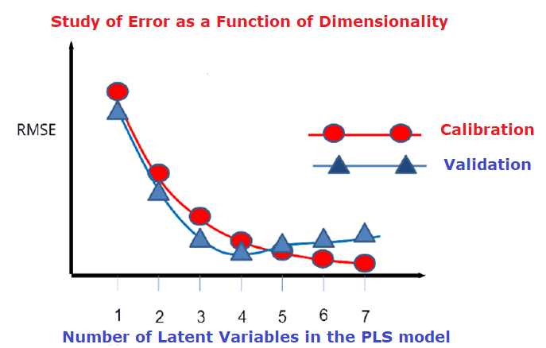
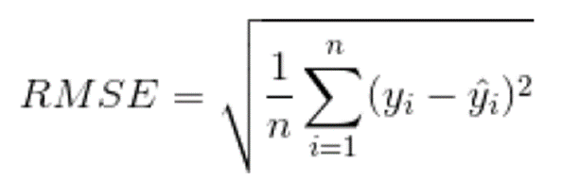
Notes:
Latent variables are determined by CROSS VALIDATION

Slide 31
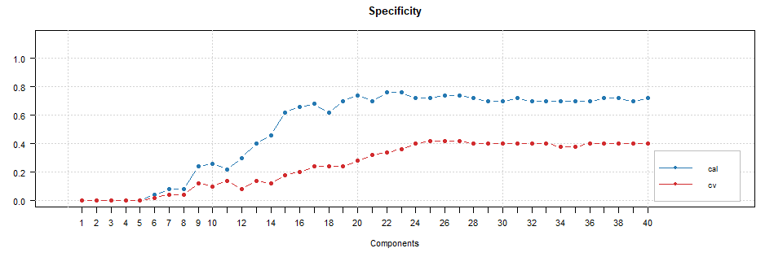
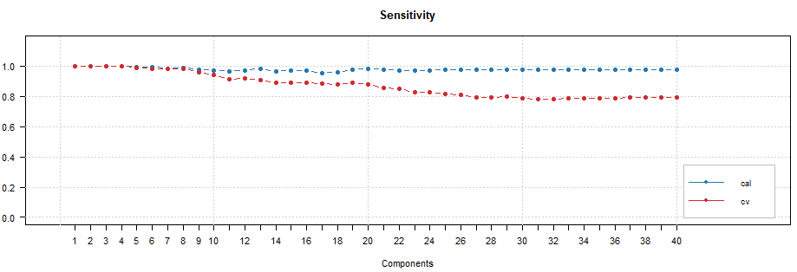

Slide 32
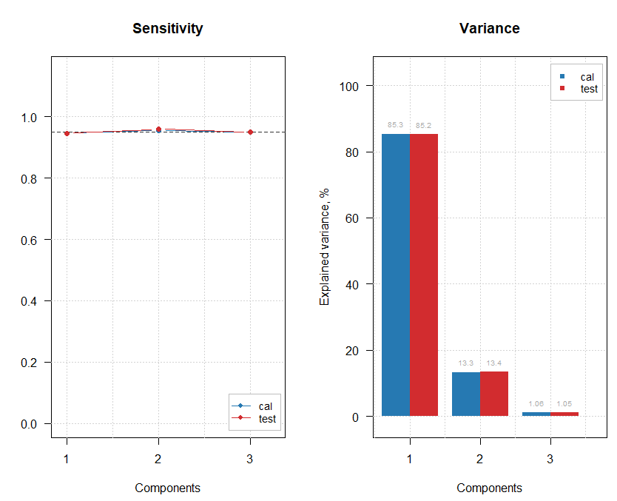

Slide 33
Materials and methods

Slide 34
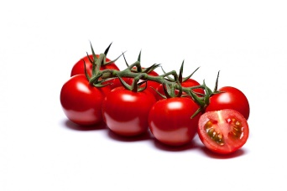
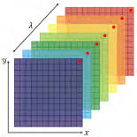
Data description
Tomatoes origin
The samples belong to 3 cultivars – Brioso, Cappricia and Provine
They all come from different greenhouses
Tomatoes were harvested fresh on the 9th and the 10th of May.
They arrived at Phenomea Laboratory, in Wageningen on Tuesday 10th May
Data set
NIR dataset: hyperspectral images (SPECIM FX17 camera) of the tomatoes from the beginning of the experiment
Reference values from the last day of the experiment, when the fungi have infected most of the sepals

Slide 35
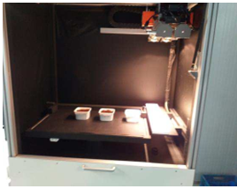
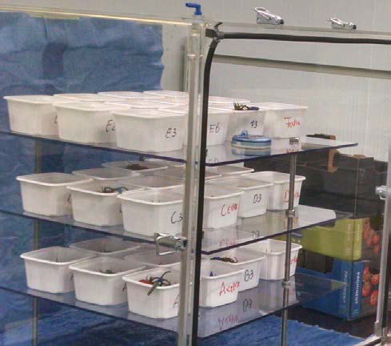
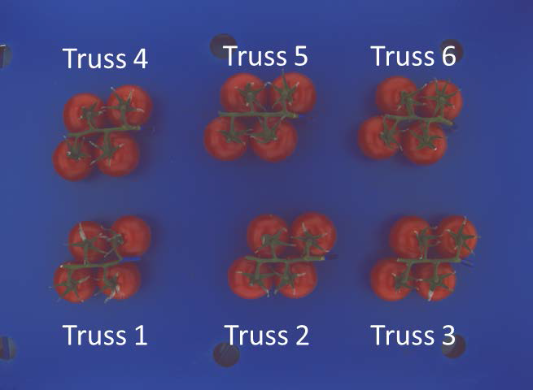
Experiment flow
1
2
3
Hyperspectral imaging
of tomato trusses using spectral cabinet*
Tomatoes in Hotbox - environment for controlled humidity and temperature
Relative humidity 100%
Taking phone images in controlled environment
*Source: Puneet Mishra, et al. All-in-one: A spectral imaging laboratory system for standardised automated image acquisition and real-time spectral model deployment, Analytica Chimica Acta, Volume 1190, 2022, 339235, ISSN 0003-2670,

Slide 36
General analysis steps
Ground truth observations were made by experts on day three and four, comprised of severity scores from zero (no fungus) to four (severe infection).
Ratings of the two days, and 3 experts were averaged
NIR spectra of sepals extracted from Hyperspectral images
Exploration of sepals at a pixel level by Principal Component Analysis
Removal of outlier pixels
Creation of qualitative models by chemometrics analysis using R studio version 4.2.1 (2022-06-23 ucrt)

Slide 37

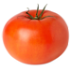
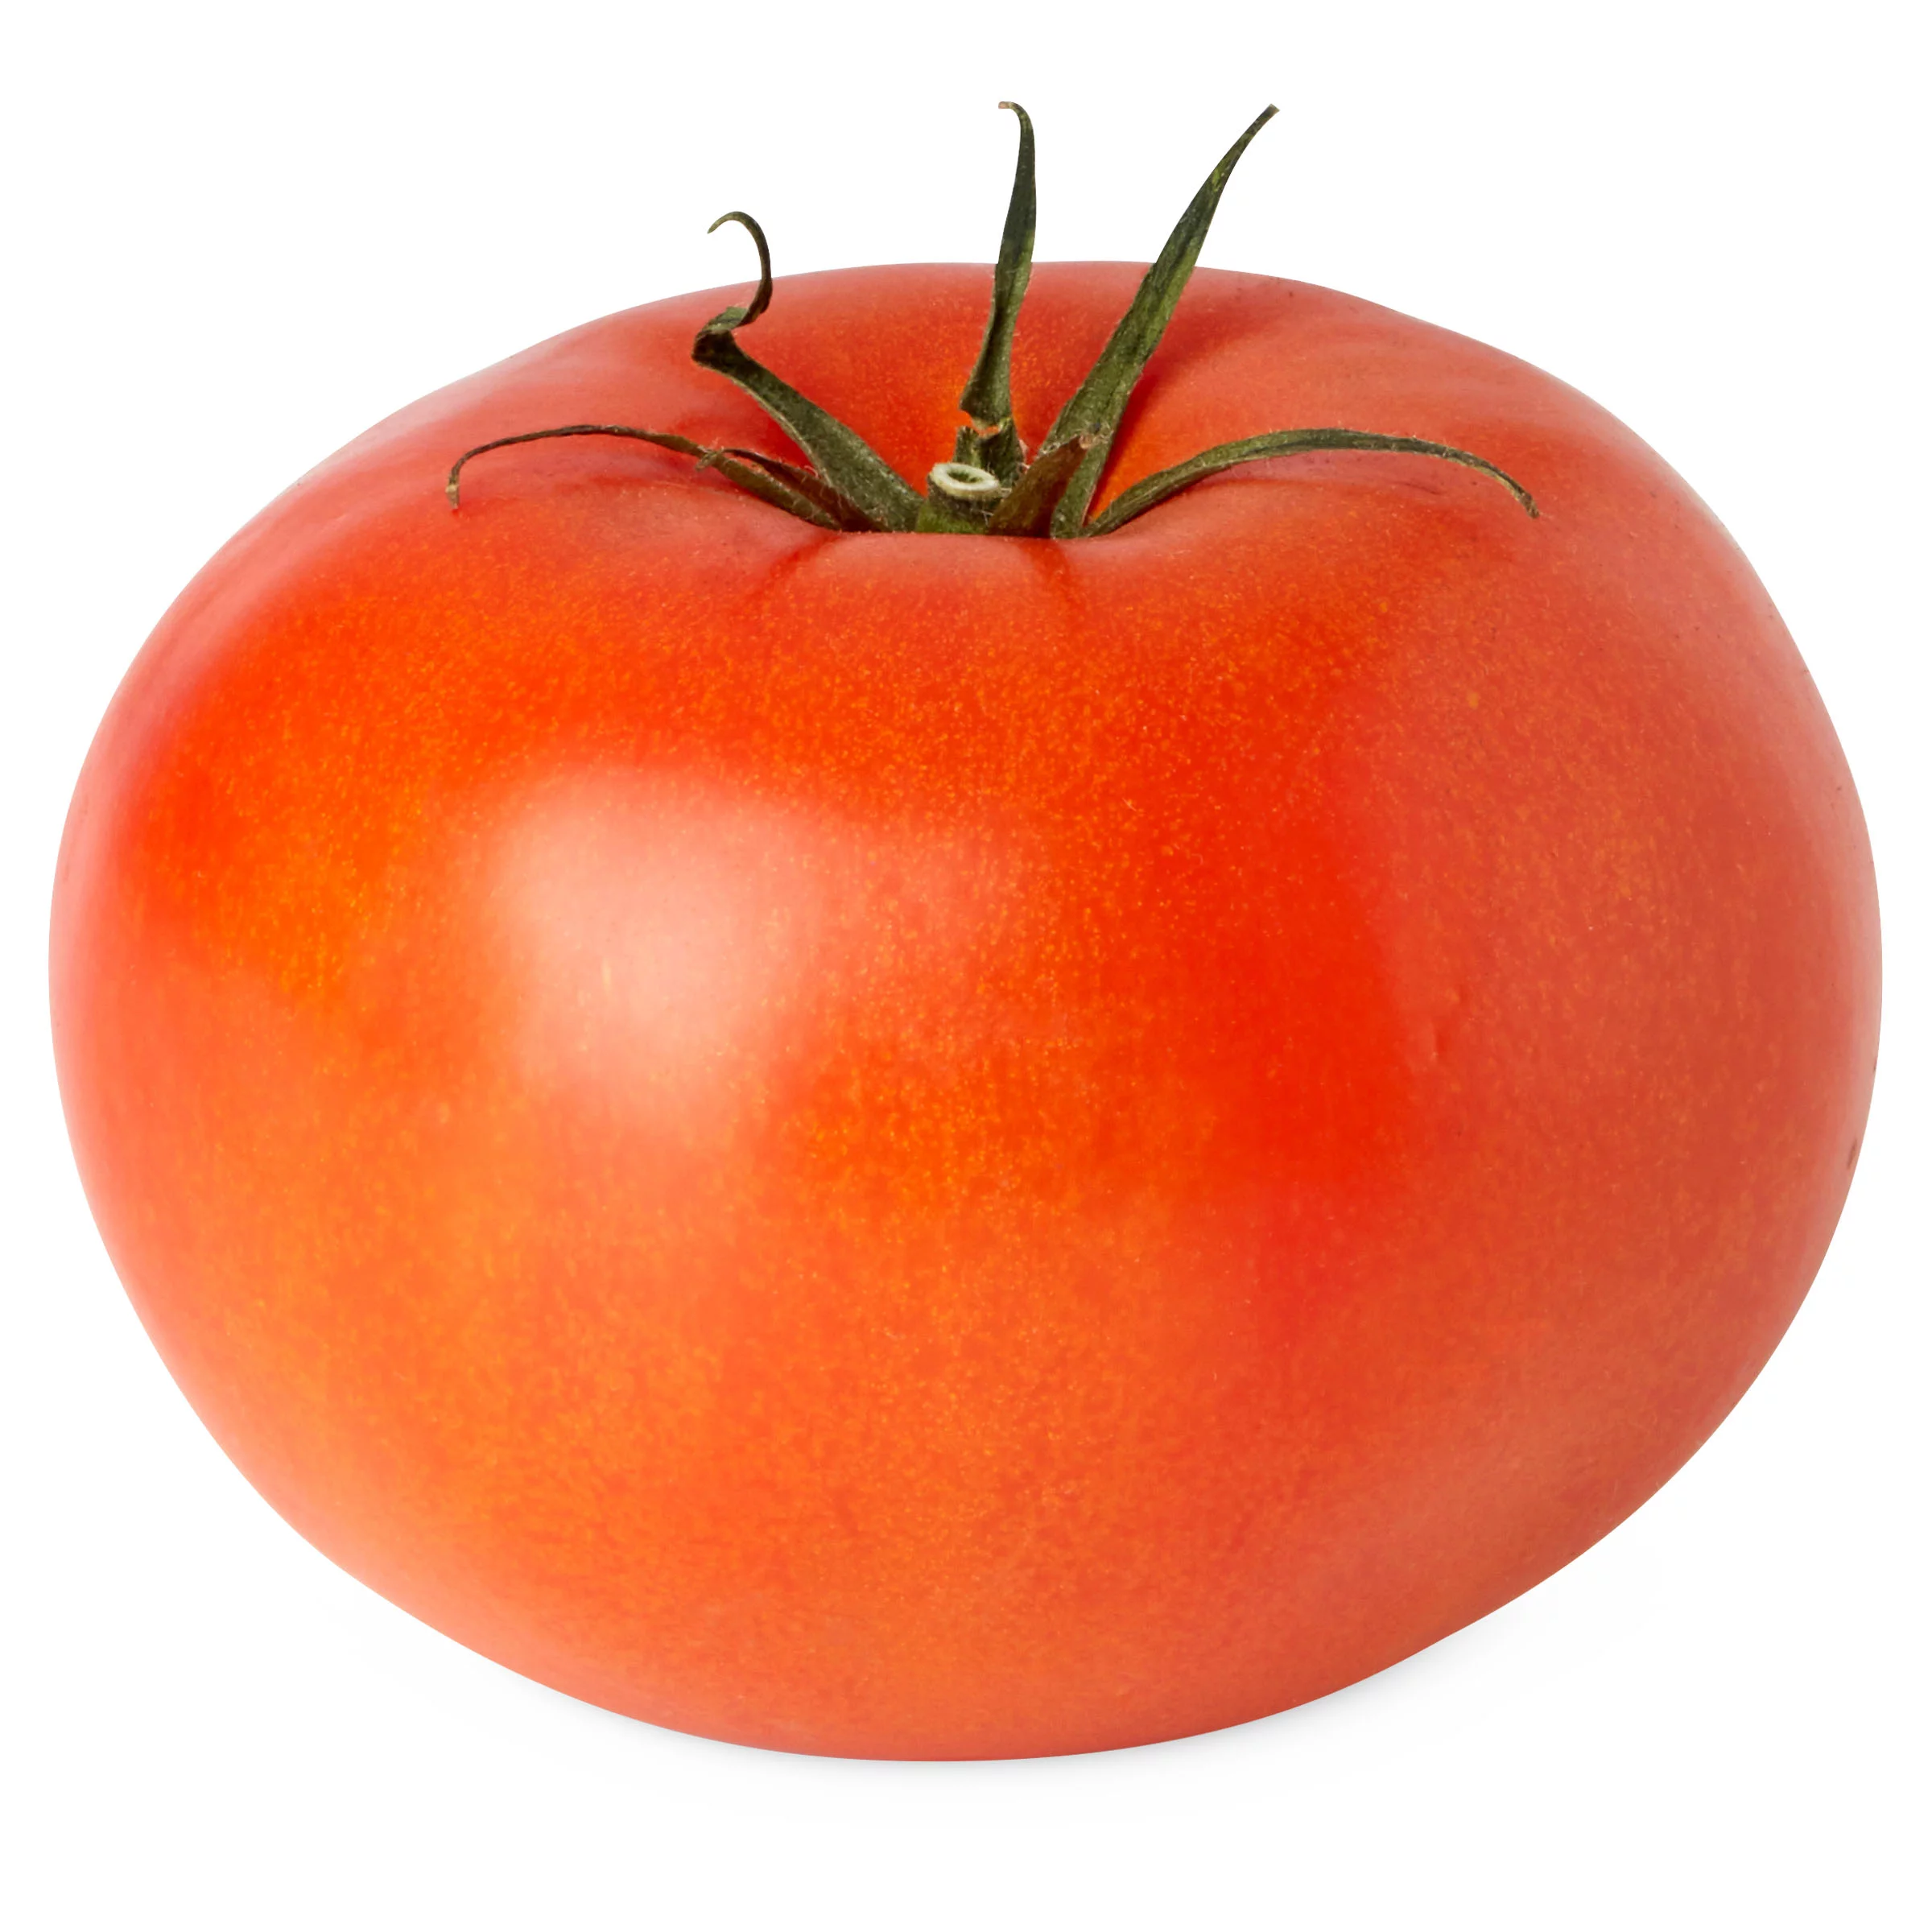

Chemometrics
R version 4.2.1 (2022-06-23 ucrt)
1
Visualization of spectra
2
Exploration by PCA and outlier removal (at pixel and sepal level by tomato, by variety and by final dataset)
3
Preprocessing of raw NIR data
4
Data split 70/30 in a representative way for each class
5
Optimization of the number of important variables by CovSel algorithm
6
Optimization of the number of latent variables by PLSDA
7
Prediction using an independent test set
Evaluation of model according to usual classification parameters

Slide 38
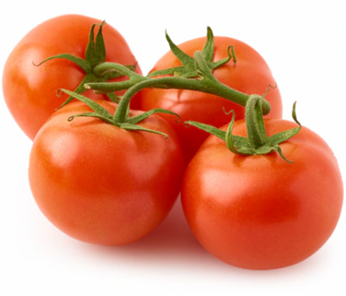
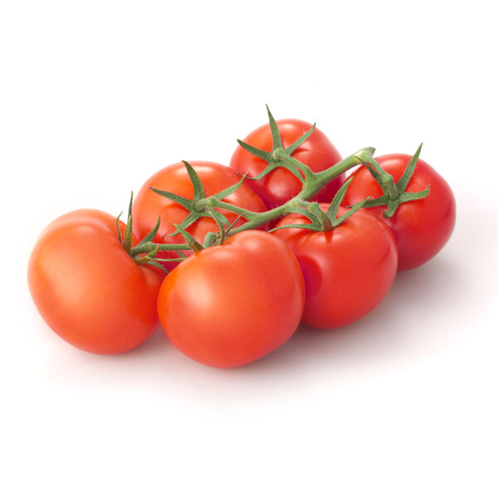
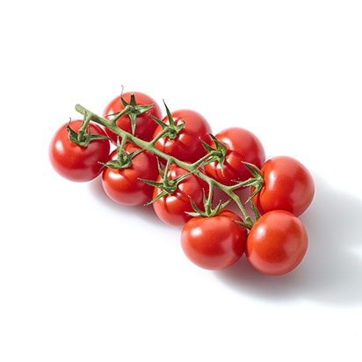
Classification design scenarios
Intravariety
Global model
Intervariety

Slide 39
Results

Slide 40
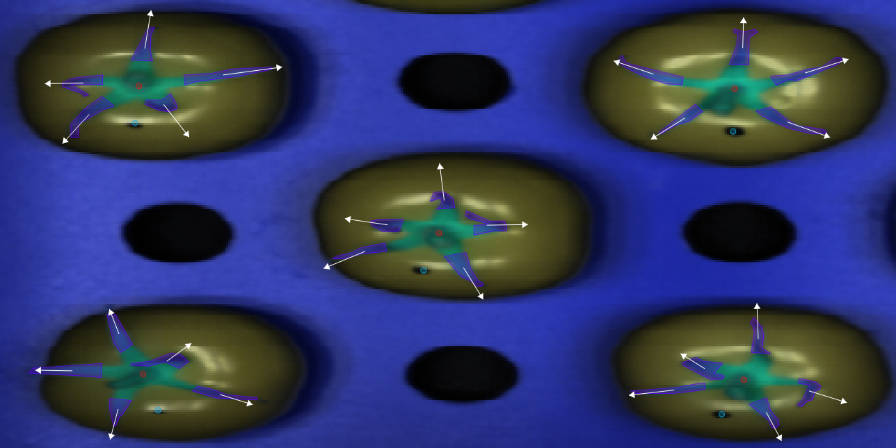
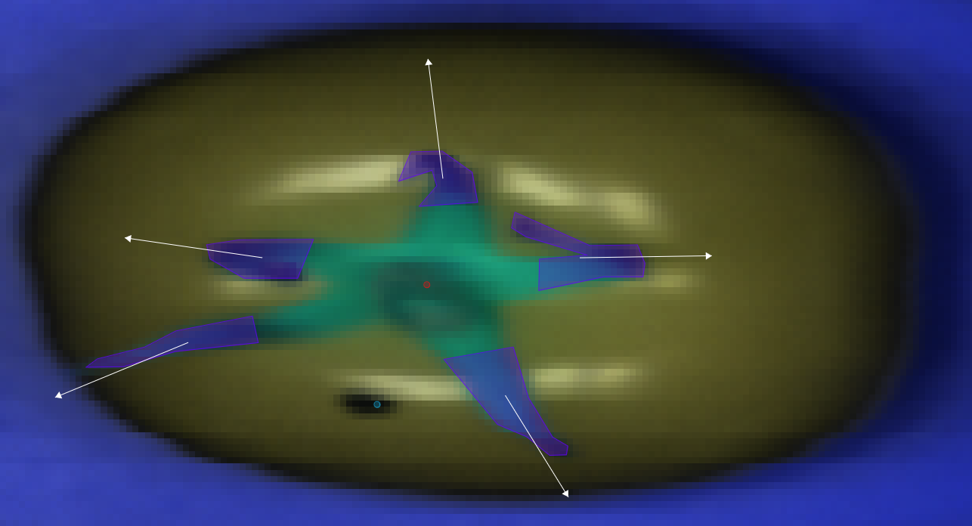
Segmentation and extraction of NIR spectra
Villiers, Hendrik de <hendrik.devilliers@wur.nl>

Slide 41
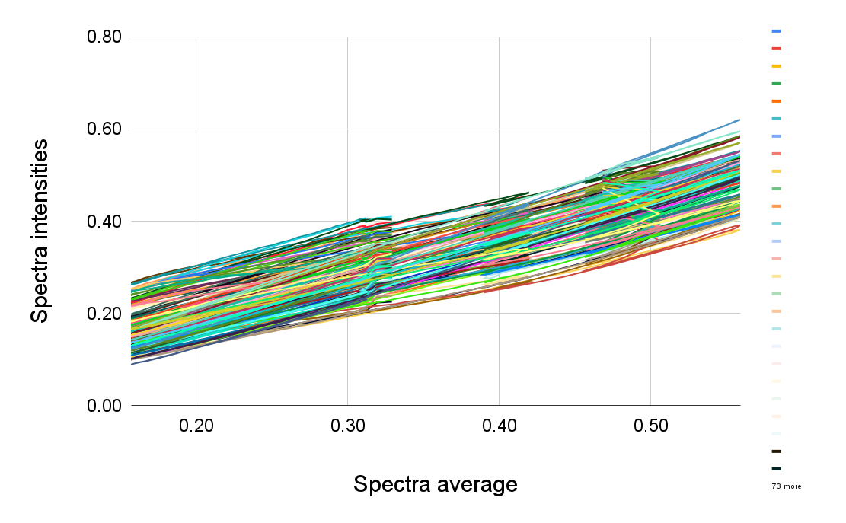
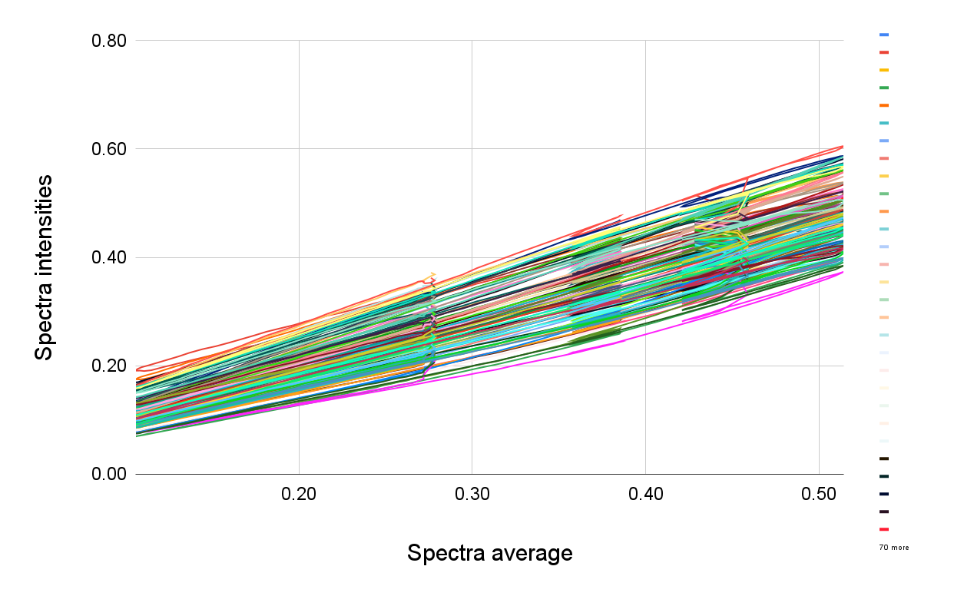
Part 3: Spectra pretreatments
Provine
Cappricia
A(λ) = kε(λ)LC + Af (λ) + Ab(λ)
Where, A: Absorbance; λ: Wavelength; A(λ): Absorbance at a particular wavelength k: multiplicative effect; ε: Molar absorption coefficient (M⁻¹ cm⁻¹); L: Optical path length (cm) C: Molar concentration; Af (λ). Additive effect at a particular wavelength caused by a certain number of photons escaping from the sensor; Ab(λ). Additive effect at a particular wavelength caused by random phenomena

Slide 42
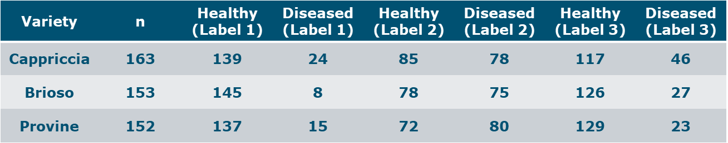
Part 4: Sampling
Labelling scenarios:
1: 0/123, 2: 01/23, 3: 0.5/123
Data split was carried out in a representative way for each class 70/30, at a sepal level
All the sepals that belong to the same tomatoes were kept together

Slide 43
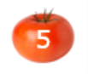
Most important variables for each variety Label 2
Cappricia | 937.33 | 944.25 | 951.16 | 965 | 1062.1 | 1083 | 1208.6 | 1320.9 | 1391.4 | 1426.7 | 1462.1 | 1561.4 | 1654.1 | 1704.1 | 1711.3
Provine | 937.33 | 944.25 | 951.16 | 978.85 | 1089.9 | 1138.7 | 1201.6 | 1299.8 | 1370.2 | 1391.4 | 1440.8 | 1554.3 | 1654.1 | 1697 | 1718.4
Brioso | 937.33 | 944.25 | 951.16 | 1089.9 | 1299.8 | 1391.4 | 1462.1 | 1589.9 | 1625.5 | 1661.2 | 1689.8 | 1697 | 1704.1 | 1711.3 | 1718.4
Global Model | 937.33 | 944.25 | 958.08 | 1055.2 | 1089.9 | 1208.6 | 1278.7 | 1363.2 | 1405.5 | 1462.1 | 1589.9 | 1654.1 | 1704.1 | 1711.3 | 1718.4

Slide 44
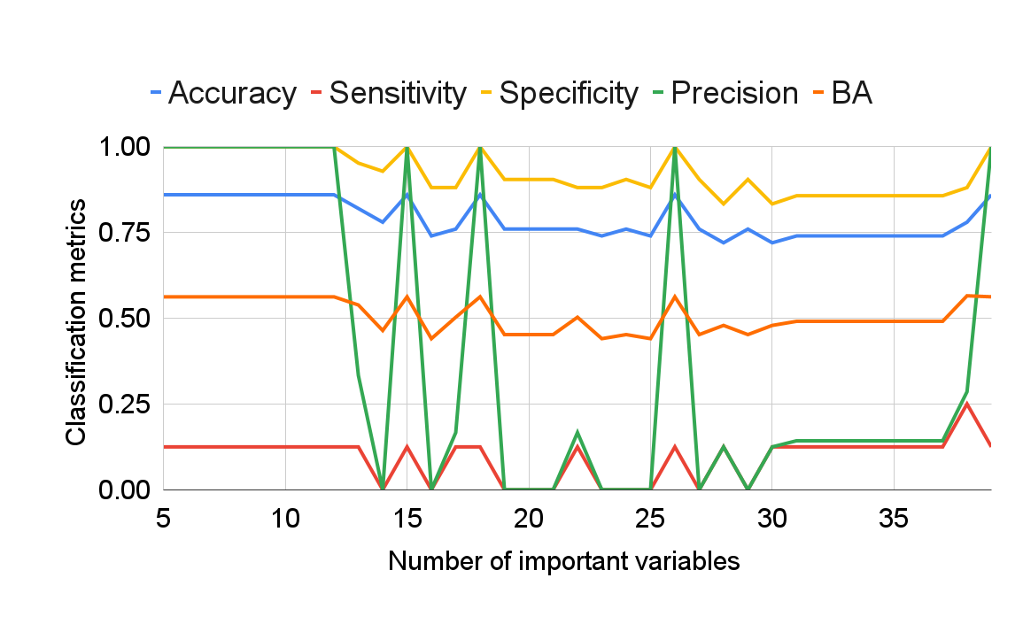
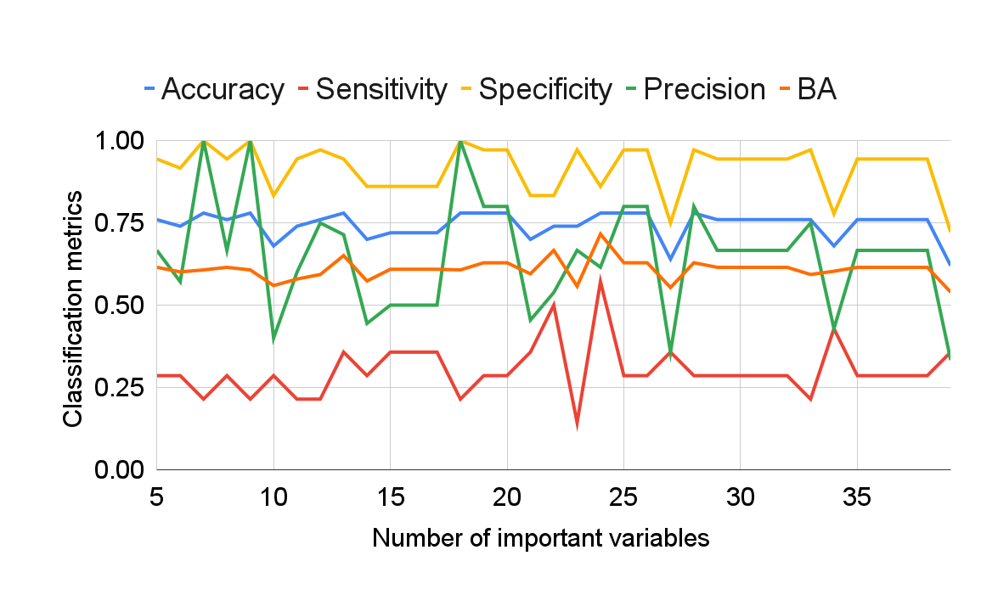
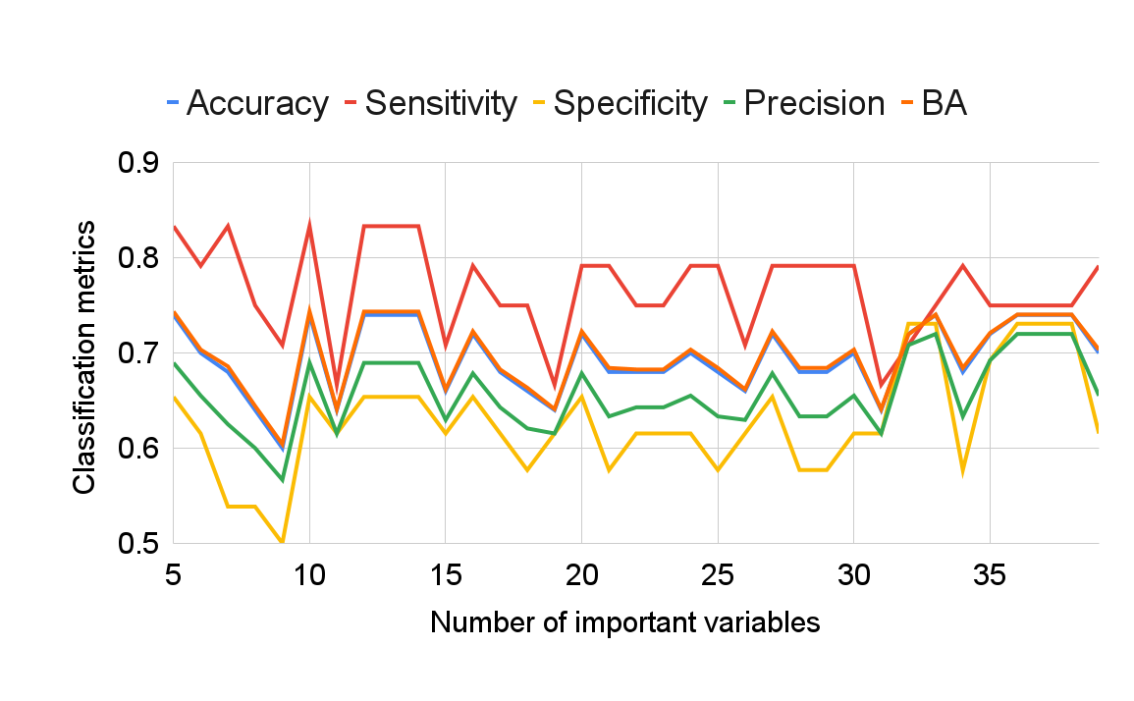
Intravariety: Cappricia classification metrics according to different number of important variables as input for PLSDA
Label 1
ACC=(TP +TN)/(TP+TN+FP+FN)
Label 3
SEN=TP/TP+FN
Label 2
PRE=TP/TP+FP
SPE=TN/TN+FP

Slide 45


Classification metrics according to different number of important variables as input for PLSDA
Brioso
Raw

Slide 46


Classification metrics according to different number of important variables as input for PLSDA
Provine
SNV

Slide 47


Classification metrics according to different number of important variables as input for PLSDA
Cappricia
Raw

Slide 48

Intervariety Label 2 SNV + SG (2,17,2) LV=3 Cal: Cappricia Val1: Brioso Val2: Provine
Data set | Real/ predicted | Healthy | Diseased | NA | SEN | SPE | PRE | AC | BA
Calibration Cappriccia | Healthy | 66 | 11 | 0 | 0.86 | 0.55 | 0.63 | 0.70 | 0.71
 | Diseased | 38 | 46 | 0 | 0.55 | 0.86 | 0.81 | 0.70 | 0.71
Validation Brioso | Healthy | 67 | 7 | 0 | 0.91 | 0.22 | 0.54 | 0.56 | 0.57
 | Diseased | 57 | 16 | 0 | 0.22 | 0.91 | 0.70 | 0.56 | 0.57
Validation Provine | Healthy | 80 | 0 | 0 | 1 | 0.03 | 0.54 | 0.54 | 0.52
 | Diseased | 69 | 2 | 0 | 0.03 | 1 | 1 | 0.54 | 0.52

Slide 49

Classification parameters for the global model “Cap&Pro” SNV + SG (2,17,2) according to the number of important variables as input for PLSDA

Slide 50


Global Model
Data set | Real/ predicted | Healthy | Diseased | NA | Sensitivity | Specificity | Precision | BA
Calibration | Healthy | 62 | 47 | 0 | 0.57 | 0.74 | 0.68 | 0.66
 | Diseased | 29 | 81 | 0 | 0.74 | 0.57 | 0.63 | 0.66
Validation | Healthy | 23 | 25 | 0 | 0.48 | 0.71 | 0.62 | 0.60
 | Diseased | 14 | 34 | 0 | 0.71 | 0.48 | 0.58 | 0.60

Slide 51
Results- Summary
Parameter/ Model | Cappricia Raw, 15v Label 3 | Cappricia SNV + SG(2,15,2), 33v Label 2 | Provine Raw, 14v Label 3 | Provine SNV, 13v Label 2 | Brioso Raw, 18v Label 2 | Intervariety Cal: Cap, Val: Bri Raw, 10v Label 3 | Global model SNV, (Cap+Pro) 6v Label 2
Accuracy | 0.83 | 0.84 | 0.71 | 0.71 | 0.66 | 0.61 | 0.70
Misclassification rate | 0.17 | 0.11 | 0.29 | 0.29 | 0.34 | 0.39 | 0.30
Sensitivity or recall | 0.89 | 0.71 | 0.08 | 0.76 | 0.43 | 0.32 | 0.81
Specificity | 0.64 | 0.89 | 0.97 | 0.65 | 0.88 | 0.89 | 0.58
Precision | 0.89 | 0.71 | 0.50 | 0.70 | 0.77 | 0.93 | 0.66
Balanced accuracy | 0.77 | 0.80 | 0.52 | 0.71 | 0.65 | 0.61 | 0.70
Geometric mean | 0.75 | 0.79 | 0.27 | 0.70 | 0.62 | 0.53 | 0.69
F-measure | 0.89 | 0.71 | 0.14 | 0.73 | 0.55 | 0.48 | 0.73
Youden’s Index | 0.53 | 0.60 | 0.05 | 0.41 | 0.31 | 0.21 | 0.39
Positive likelihood ratio | 2.47 | 6.45 | 2.67 | 2.17 | 3.58 | 2.91 | 1.93
Negative likelihood ratio | 0.17 | 0.32 | 0.95 | 0.37 | 0.65 | 0.76 | 0.33

Slide 52

Classification metrics of the optimized models

Slide 53

Comparison of outlier detection methods in terms of their performance in the validation set

Slide 54

The best results in terms of balanced accuracy were found by detecting outliers with Isolation Forest, and performing SNV, then the average of remaining pixels

Slide 55
Results
Out of all the sepals that did not have the disease, how many got negative test results?
High proportion of actually healthy sepals that were correctly predicted out of all positive predictions made by the models
Cappricia: 0.71
Provine: 0.76
Global model: 0.81

Slide 56
Results
Out of all the sepals that do have the disease, how many got positive results?
The ability of a test to correctly classify an individual sepal as diseased
Cappricia: 0.89
Provine: 0.65
Global model: 0.58

Slide 57
Results
A good performance on positive and negative classes respectively was found in Cappricia Intravariety model:
High positive likelihood ratio of 6.45 (above 1: increased evidence for disease-free) for Healthy class
Low negative likelihood ratio of 0.32 (increased evidence for disease) for Diseased class
BA reduced to the traditional accuracy (0.70) in the global model showing that the classifier performed equally well on either classes
The intervariety models calibrated in Cappricia showed high sensitivity in class one (0.91) and low specificity in class two; this was consistent in prediction for Brioso (0.03) and Provine (0.11)

Slide 58
Conclusions

Slide 59
Conclusions
A new global model was calibrated on two different tomato cultivars: Cappricia and Provine; and evaluated in independent samples, using Standard Normal Variate and 6 important variables by CovSel
The optimized model achieved a sensitivity of 0.81, specificity of 0.58 and balanced accuracy of 0.70
The model presented potential as a fast alternative method to grade recently harvested tomatoes before the fungal infection is visually observed
The best results in terms of balanced accuracy were found by detecting outliers with Isolation Forest, and performing SNV, then taking the average of the remaining pixels

Slide 60
Conclusions
Novelty of this work - investigate HSI to capture the sepal susceptibility of fungal infection by chemometric analysis of different varieties of tomatoes
The results from this research reaches to a conclusion that discrimination between more susceptible and less susceptible samples is feasible under controlled conditions
Unanswered questions:
What is the information that the spectra captures in these samples to help discriminate the susceptibility to fungus?
How will the global model perform when predicting samples from another harvesting time?
These questions are the likely to set the directions for new investigations on this subject

Slide 61




Thank you for your kind attention
Notes:
ACKNOWLEDGMENTS

Slide 62
References
Brdar, S., Panić, M., Hogeveen-van Echtelt, E. et al. Predicting sensitivity of recently harvested tomatoes and tomato sepals to future fungal infections. Sci Rep 11, 23109 (2021). https://doi.org/10.1038/s41598-021-02302-2
Paper 942-2017 Predictive Accuracy: A Misleading Performance Measure for Highly Imbalanced Data Josephine S Akosa, Oklahoma State University https://support.sas.com/resources/papers/proceedings17/0942-2017.pdf
Roger, J.-M.; Mallet, A.; Marini, F. Preprocessing NIR Spectra for Aquaphotomics. Molecules 2022, 27, 6795. https://doi.org/10.3390/molecules27206795

